Slide 1
Deep Space and Exploration Missions to Mars
By Matthew Katterman

Slide 2
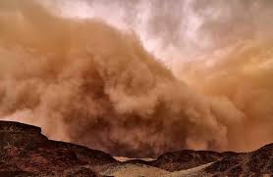
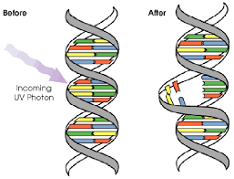
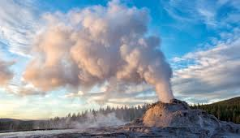
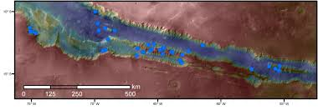
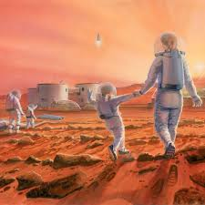
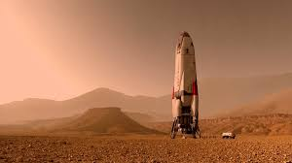
Exploring if Mars is Habitable
Requirements for habitation
Safe Environment
Limit to amount of UV radiation
Limit to severe weather conditions
Water supply
Pockets of underground water & ice
Energy
Supplies of geothermal energy
Would need space suit
Mars has greatly reduced air pressure.
Mars only has 0.16 % oxygen in it.
Human Exploration of Mars will happen many times before possible habitation.

Slide 3
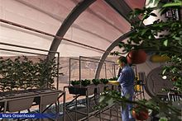
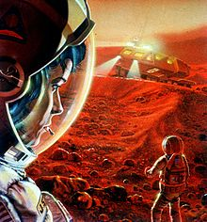

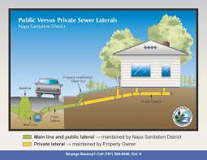
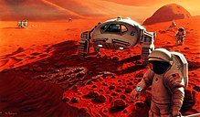
Infrastructure needed for Colonization of Mars
Food production spaces
Resource extraction
Water, minerals, oxygen, methane
Energy production
Solar, geothermal, hydrogen
Utilities providence
Waste disposal, sanitation, water recycling, oxygen, power, communications providence.
Transportation and living equipment
Space suit, rovers, possible aircraft.

Slide 4
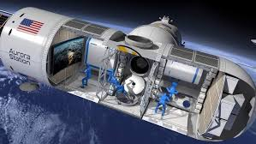
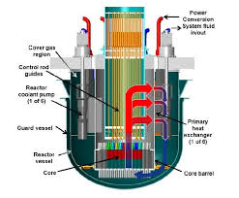
Importance of Life Support Systems for Deep Space Missions
Life support systems needed on spacecraft to get us to Mars, also used in the habitats that people would live in.
Would need sustainable systems that provide and recycle the following.
Produce oxygen, hydrogen and methane.
Remove and recycle carbon dioxide from the air.
Recycle and reuse all possible sources of water, including water vapor, wastewater, urine.
Produce water from hydrogen and carbon dioxide.
Maintain the correct humidity and temperatures.
Methane
Oxygen
Carbon Dioxide
Water
Hydrogen
REACTORS

Slide 5
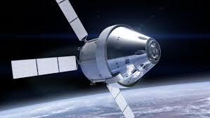
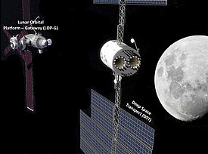
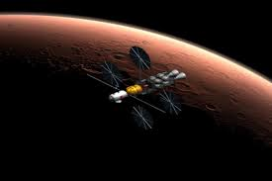
Deep Space Transport to Mars
First human crewed missions to Mars would be just for Science Exploration purposes.
Would begin towards the end of 2020’s or early 2030’s.
DST consists of an Orion Capsule and a habitation module. Would be docked to the Lunar Gateway space station first.
The first few missions would just orbit Mars and not land on it. It takes ~ 9 months to get to Mars. Missions planned for up to 1,000 days.
Would start with one year flight tests before starting the actual missions.

Slide 6
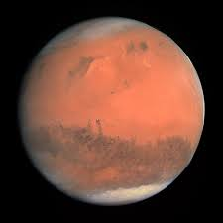
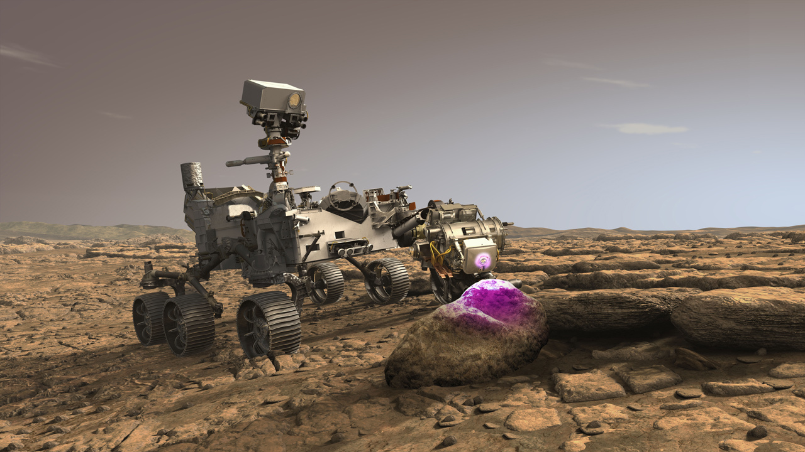
Mars Exploration Program (MEP)
Will give valuable information to help us answer important questions or fulfill certain goals.
How Mars compares and contrasts with Earth
The potential of Mars to have hosted life on it.
How geologic and climatic processes have shaped Mars into the planet it is now.
The potential exploration of Mars by humans.
Having a continual scientific presence on the planet.
Providing improvement to subsequent robotic type of Mars exploration missions.

Slide 7
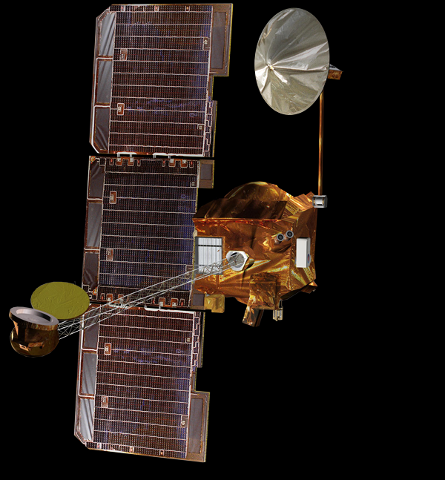
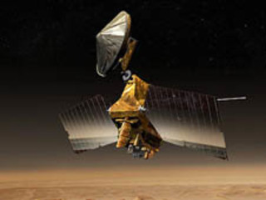
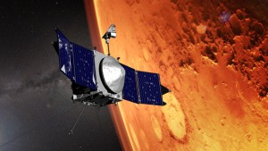
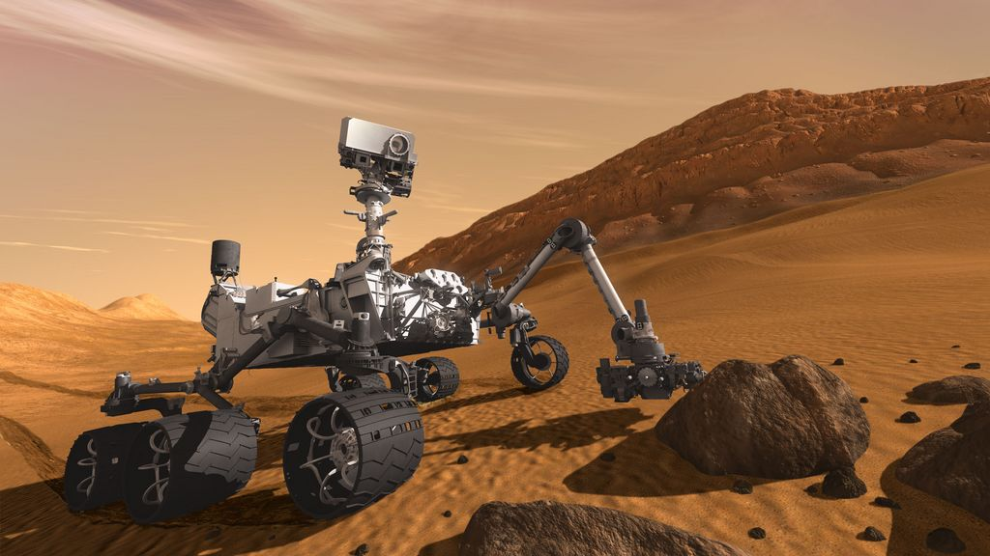
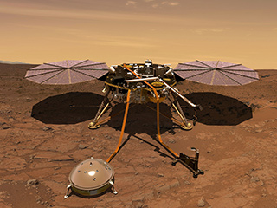
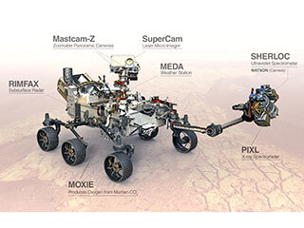
Past and Present Exploration Missions
Odyssey Orbiter
(2001)
Reconnaissance Orbiter
(2006)
Maven Orbiter
(2014)
Curiosity Rover
(2012)
Insight Lander
(2018)
Perseverance Rover
(2021)

